Slide 1
FM Synthesis

Slide 2
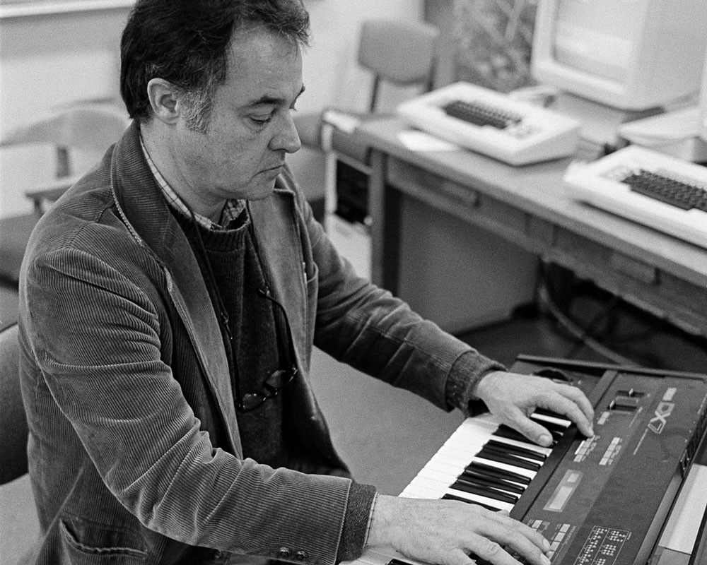
FM synthesis
Modulation - varying properties of periodic waveform, the carrier signal, with a modulating signal.
FM synthesis - Creating sound by modulating the frequency of a waveform using another waveform
Chowning, John M. "The synthesis of complex audio spectra by means of frequency modulation." Journal of the audio engineering society 21.7 (1973): 526-534.
Vary A – Amplitude modulation
Vary f – Frequency modulation
Vary φ – Phase modulation
$$x(t)=A\sin{(}2πft+φ)$$

Slide 3


Frequency modulation synthesis
Simple sine wave
x(t) – the carrier
f _{c} – carrier frequency, or frequency offset, gives fundamental frequency
Now modulate the frequency
f (t) – the modulator
f _{m} –modulation frequency
D – modulation depth
Chowning originally did phase modulation
$$x(t)=\sin{(}2πf_{c}t)$$
$$f(t)=D\sin{(}2πf_{m}t) \\ →x(t)=\sin{(}2π(f_{c}+f\left(t\right))t) \\ =\sin{(}2π(f_{c}+D\sin{(}2πf_{m}t))t)$$
$$f(t)=D\sin{(}2πf_{m}t) \\ →x(t)=\sin{(}2π{(f}_{c}t+f(t))) \\ =\sin{(}2π(f_{c}t+D\sin{(}2πf_{m}t)))$$
Notes:
See https://www.eeeguide.com/theory-of-frequency-modulation-and-phase-modulation/
http://www.cs.cmu.edu/~music/icm-online/readings/fm-synthesis/fm_synthesis.pdf

Slide 4
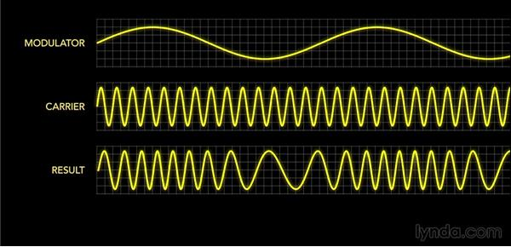
Example

